Slide 1
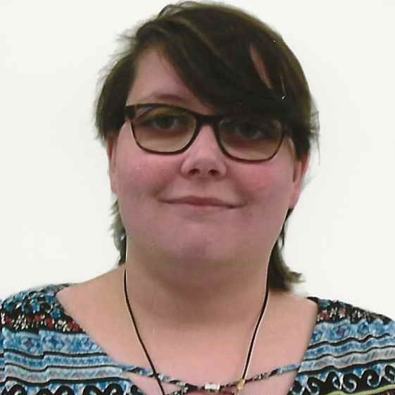
PROFILE
Jenny Haggerty
Jenny graduated from Tennessee Tech with a bachelor’s in computer science in 2019. After graduation, Jenny has worked in for a government contracting for just under two and a half years. She has worked for Deloitte for just under 2 years. She worked mostly in web development with react js front end with java spring boot APIs, but she is always up for learning something new.
EDUCATION: bachelor in Computer Science
Java Full Stack Developer
EMAIL
jjhaggerty@deloitte.com
WORK LOCATION
Rockledge, FL
RECENT EXPERIENCE
SKILLS
Texas TSS- Child care portal
Moderation effort to childcare application process and maintenance, as well as for the public to find childcare
Role: As a developer, I worked on design and workflows for different forms needed to receive and maintain childcare authorization, using the Lift framework.
Texas TSS- Imtrac
Moralization effort to update the imtrac site.
Role: update pages into react as closely as possible to the originals.
Saic
Worked on a project to create an inhouse library for a client.
Role: full stack developer. Create Pages that followed the clients vision using react, create the REST Apis that were used in Java spring boot as well as some aws work.
Software/Languages
React.js
React Lift
Java (Spring Boot, Spring Cloud)
HTML, CSS
JavaScript
Git/ GitHub, Bitbucket
REST, Microservices.
General Tools
Jira
Microsoft Excel, Microsoft PowerPoint, Microsoft Word.

